Slide 1
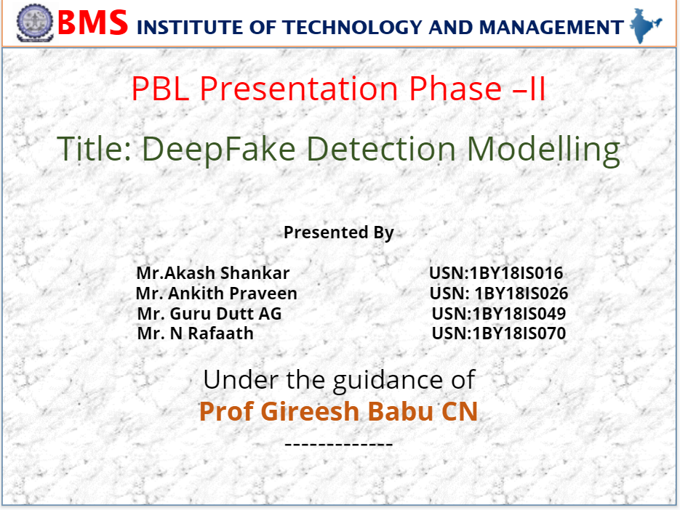
PBL Presentation Phase –II
Title: DeepFake Detection Modelling
Presented By
Mr.Akash Shankar USN:1BY18IS016
Mr. Ankith Praveen USN: 1BY18IS026
Mr. Guru Dutt AG USN:1BY18IS049
Mr. N Rafaath USN:1BY18IS070
Under the guidance of
Prof Gireesh Babu CN
-------------

Slide 2
Introduction
Deepfakes are synthetic media in which person in an existing image or video is replaced with someone else’s likeness.
Deepfakes technology is a face swap technique that enables anyone to replace faces in a video, with highly realistic results. Despite its usefulness, if used maliciously, this technique can have a significant impact on society, for instance, through the spreading of fake news or cyber bullying.
It leverages powerful techniques from Machine Learning to manipulate or generate visual and audio content with a high degree of potential to deceive the viewers.
CNN+LSTM consists of several blocks of convolutional layers with an LSTM head. Each layer preceding an LSTM is time distributed, meaning that it was applied to every time step in an input example. Input to the network was 4-dimensional, with the 4th dimension corresponding to time

Slide 3
Objectives
To provide a timely overview of deepfake creation and detection methods and presents a broad discussion of challenges, potential trends, and future directions. We conduct this project with a different perspective and taxonomy compared to existing survey papers on the same topic. Informative graphics are provided for the latest development in deepfake research. The methods surveyed are comprehensive and will be valuable to the artificial intelligence community in tackling the current challenges of deepfakes
Many models and algorithms have been implemented and companies like Google and Facebook are investing large amounts of resources to the task. This project aspires to contribute to this.

Slide 4
Facial Video Manipulation
Identity Modification: Means to replace a person’s face with someone else’s.
Expression Modification: Changing a person’s facial expressions and lip movements.
Models to be taken into account:
  FaceSwap [identity modification]: Facial landmarks are detected, 3D model of the source actor’s face is created and then transformed to match the facial landmarks of the target actor
  Deepfake: AutoEncoder Neural network,consists of encoder for compressing the original data and decoder for trying to reconstruct the original image, both part of DNN, needs to be trained on data similar to input for autoencoder.
  Face2Face [expression modification: created 3D models of faces of source and tracks deformations in model then transfers to target. Principal Component Analysis(PCA) us used to track and parametrize the faces.

Slide 5
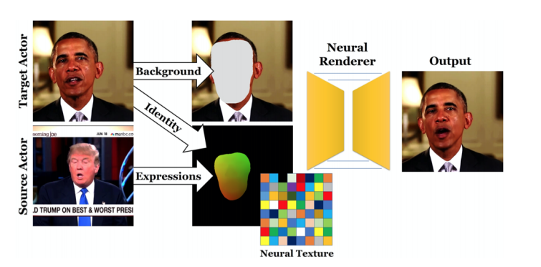
NeuralTextures: They replace features of the object with learned ones using images of 3D object as input.
A viewpoint and uv-map links elements in neural texture map to points in the object.
When connected with a Neural Renderer, trained with the neural texture, it can generate an image of the object from the given viewpoint.

Slide 6
Applications
Education: Deepfake technology facilitates numerous possibilities in the education domain. Schools and teachers have been using media, audio, video in the classroom for quite some time. Deepfakes can help an educator to deliver innovative lessons that are far more engaging than traditional visual and media formats.
Public Safety & Digital reconstruction: Reconstructing the crime scene is a forensic science and art, using inductive and deductive reasoning and evidence. AI-Generated synthetic media can help reconstruct the scene with the interrelationship of spatial and temporal artefacts.
Politics: Deepfakes have been used widely to malign the reputation of people in the higher authorities of different countries. For example Donald Trump during Oval Office Address and in 2020, the Delhi BJP Party used deepfakes to distribute a English language campaign message by Manoj Tiwari and it was translated into Haryanvi to target specific voter entourage.
Blackmail: Deepfakes can be used to generate blackmail materials that falsely incriminate a victim. Since the fakes cannot reliably be distinguished from genuine materials, victims of actual blackmail can now claim that the true artifacts are fakes, granting them plausible deniability.

Slide 7
Detection Methods
Given an image sequence, a convolutional LSTM is employed to produce a temporal sequence descriptor for image manipulation of the shot frame. Aiming at end-to-end learning, an integration of fully-connected layers is used to map the high-dimensional LSTM descriptor to a final detection probability.
LSTM can be divided into a CNN and a LSTM, which we will describe separately in the following paragraphs.
CNN for Feature Extraction: The 2048-dimensional feature vectors after the last pooling layers are then used as the sequential LSTM input.
LSTM for Sequence Processing: The key challenge that we need to address is the design of a model to recursively process a sequence in a meaningful manner. For this problem, we resort to the use of a 2048-wide LSTM unit with 0.5 chance of dropout, which is capable to do exactly what we need.

Slide 8
Implementation
Using a dataset of videos from Kaggle currently. Dataset will be split into 80:10:10 of training, testing and validation
Video is fed into one of the two Image feature extraction networks that includes:
  InceptionResNetV2
  Xception: part of the ResNet architecture
The output of these is fed into a small Long Short term Memory network (LSTM). It is used to process the frames in a sequential manner so that analysis of the video can be made by comparing frame at ‘t’ second with frame of ‘t-n’ seconds.
This is then connected to a classification later, outputting either “0” for manipulated video or “1” for pure video.
For the LSTM Network, half the videos that will be used for training are normal and other half manipulated. ADAM optimiser, binary cross entropy loss with a batch dropout of 0.5.

Slide 9
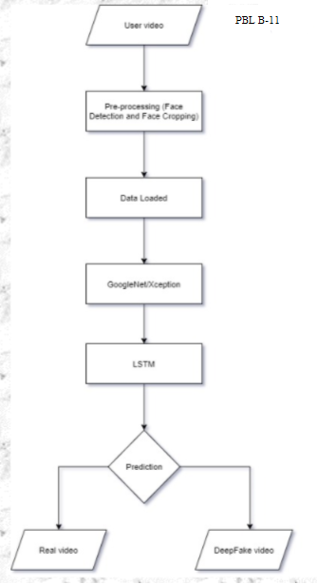

Slide 10
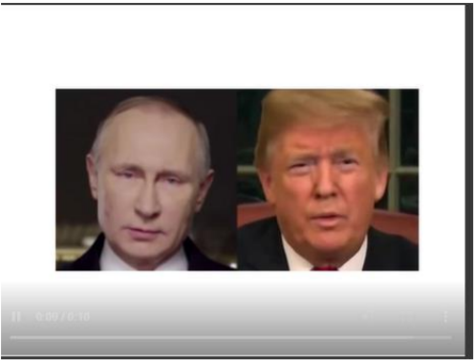
Results

Slide 11
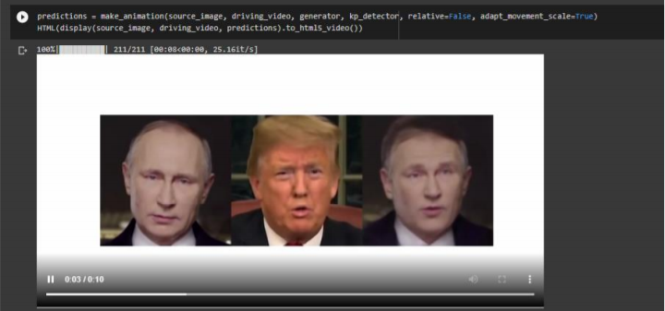

Slide 12
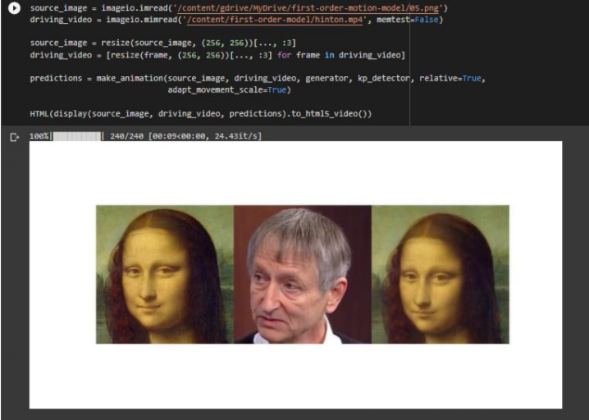

Slide 13
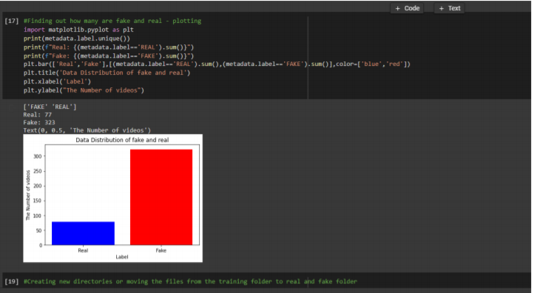

Slide 14
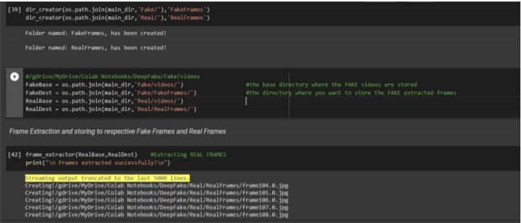

Slide 15
Conclusion
We have presented a temporal-aware system to automatically detect deepfake videos. Our experimental results using a large collection of manipulated videos have shown that using a simple convolutional LSTM structure we can accurately predict if a video has been subject to manipulation or not.
In future work, we plan to explore how to increase the robustness of our system against manipulated videos using ensemble of models during training to boost our accuracy and inputting the audio feature of a video and detecting the deepfake.

Slide 16
References
[1] https://www.alanzucconi.com/2018/03/14/introduction-to-deepfakes/
[2] https://www.alanzucconi.com/2018/03/14/an-introduction-to-autoencoders/
[3] FaceForensics++: Learning to detect manipulated Facial Images from https://arxiv.org/pdf/1901.08971.pdf
[4] Detection of Deepfake Video Manipulation(2018) in https://www.researchgate.net/profile/5c1bdf7da6fdccfc705da03e/Detection-of-Deepfake-Video-Manipulation.pdf
[5] Deepfake Video Detection Using Recurrent Neural Networks in https://engineering.purdue.edu/~dgueraco/content/deepfake.pdf

